Slide 1
“SHOW ME” COVID DATA!
EXAMINING THE RATES OF COVID-19 ACROSS POPULATIONS IN THE COUNTIES OF MISSOURI
Katherine Comfort-Mason, Melissa Memel, David Ruppel & Christopher Wecke

Slide 2
motivation
The group wanted to choose a topic that met 2 conditions:
Relevant subject matter
Personal experience with subject matter
All conversations eventually led back to COVID-19.
We wanted to compare COVID-19 rates (Cases, Deaths, Mortality Rate) across Missouri (defined scope) using these variables:
Population density
Median income
Percent of population over 65
Percent of population without health insurance
Percent of population under the poverty line

Slide 3
Data sources
There is no shortage of COVID-19 data, which made it difficult to narrow down the search.
We initially looked at a wide range of sources, including the NYTimes and findings by SLU professor, Chris Prener. We also looked at health.mo.gov and meric.mo.gov for county size, insurance etc.
The SLU data also included data from the Missouri Covid Tracking Project.
The sources we used had an incredible amount of data – hospital capacity, beds in use, ICU beds, hospitals reporting vs. those that don’t, total tests, area of county, and breakdowns of population by everything from race to education degrees to usage of carpools.
We began exploring several repositories of data before finding 2 primary sources:
covidcountydata.org
US Census County List

Slide 4
Data cleaning
Covid County Data API allowed us to combine Covid datasets with the county-level demographic data.
The only thing missing from the dataset was the county name.
This was pulled from the US Census Bureau county dataset using the FIPS ID.
This caused issues since the FIPS ID in one dataset was an integer and the other was an object.
Converting the FIPS to an object was difficult because the leading zeroes were necessary (not for Missouri, but for the entire US dataset).
We were not successful, mainly due to the fact that the MO data was fine (no leading zeroes), so the team decided it was not worth the effort.

Slide 5
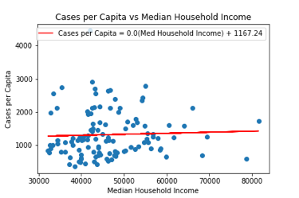
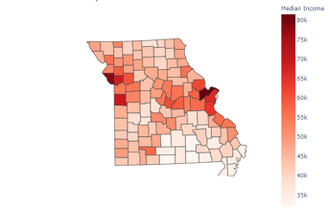
Cases per capita vs. median household income
Notes:
Median household income has little to no effect on cases.

Slide 6
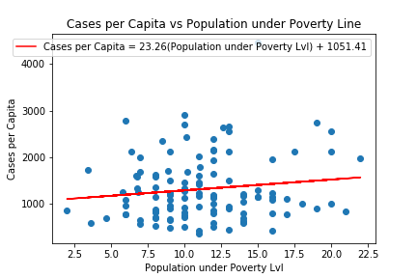
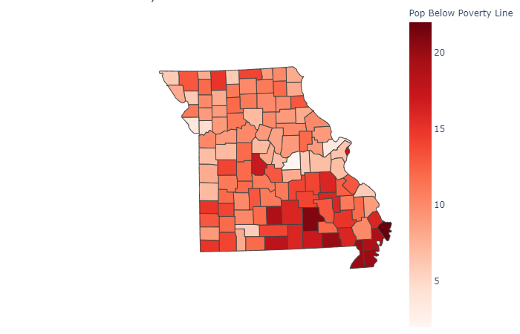
Cases per capita vs. pop. Below poverty line
Notes:
Poverty line has little effect on cases.

Slide 7
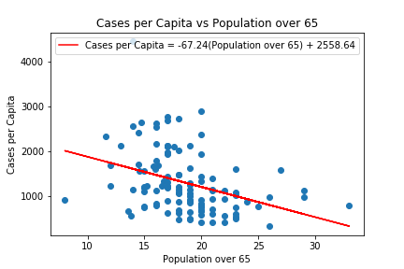
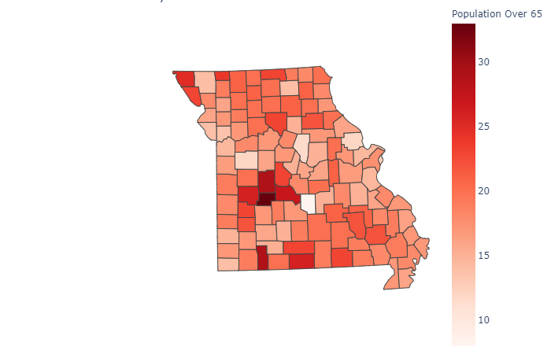
Cases per capita vs. Population age 65+
Notes:
Less populated areas experienced lower impacts. Already established isolated lifestyles likely contributed to lower per capita rates. No. 1 – Hickory County – 33% over 65

Slide 8
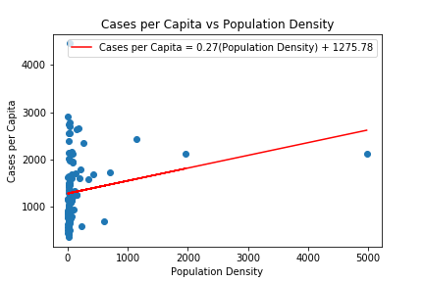
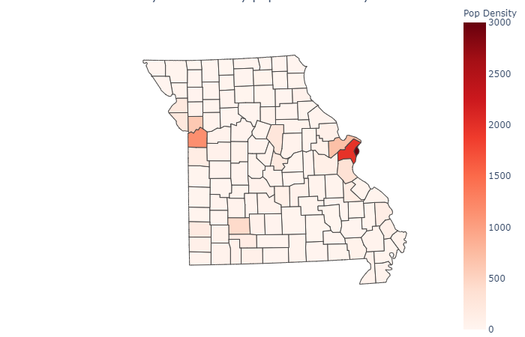
Cases per capita vs. population density
Notes:
Definitely more prevalent in populated counties

Slide 9
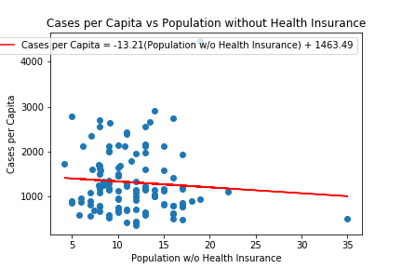
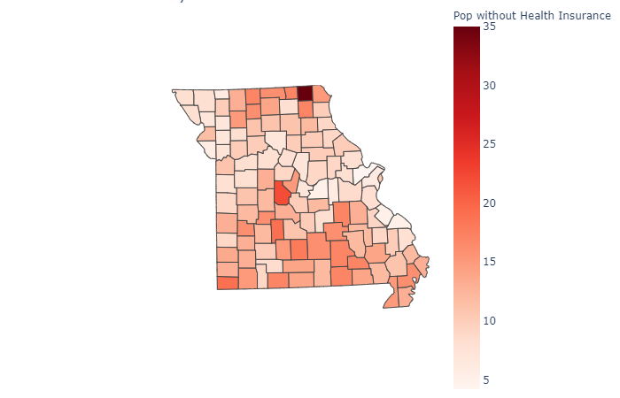
Cases per capita vs. uninsured population
Notes:
Far lower rates than expected. Uninsured populations are less likely to be tested and therefore diagnosed. May also be exhibiting especially careful behaviors, given threat.
No. 1 – Scotland County (35%) No. 2 – Morgan County (22%)

Slide 10
CONCLUSIONS
Our project suffers several shortcomings – primarily lack of individual result analysis and comparison to state, region, national, and global metrics.
Even with these flaws, our results show that Covid does not discriminate.
However, we postulate that correlation was not evident due to the following:
Age 65+: Population not venturing into public for potential exposure.
Uninsured: Population less likely to seek medical attention, e.g. testing.
Median income: As a group, we supposed that the poverty line variable would have been more significant and more accurate than median income, but that did not prove out – most likely due to a potential correlation with uninsured rate (another gap in the study).

Slide 11
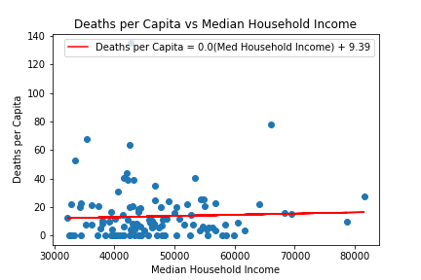

deaths per capita vs. Median household income

Slide 12
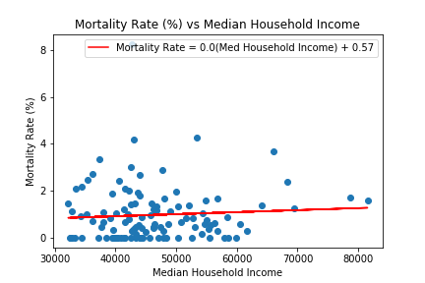
Mortality rate vs. Median household income

Slide 13
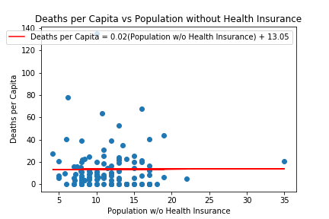

deaths per capita vs. uninsured population

Slide 14
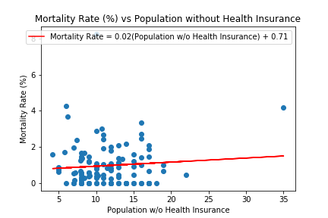
Mortality rate vs. uninsured population

Slide 15
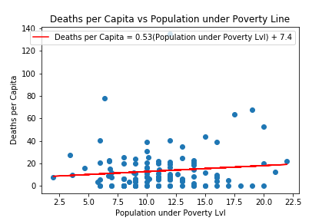
deaths per capita vs. pop. Below poverty line

Slide 16
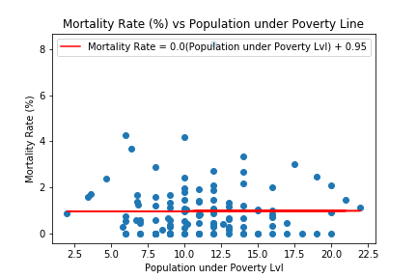
Mortality rate vs. pop. Below poverty line

Slide 17
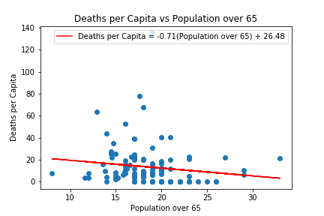
deaths per capita vs. Population age 65+

Slide 18
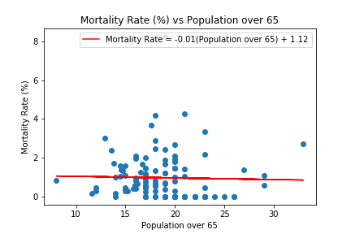
Mortality rate vs. Population age 65+

Slide 19
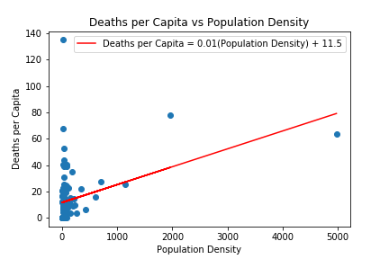
deaths per capita vs. population density

Slide 20
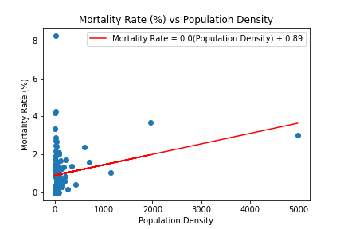
Mortality rate vs. population density
Notes:
Top areas – STL and KC metro areas.

